Slide 1


Introduction to Compassionate Leadership Behaviours:
Ross Young
Leadership and Team Change Facilitator
ross.young@wales.nhs.uk

Slide 2
Activity: Count to Ten

Slide 3
Compassion
‘a sensitivity to suffering in self and others with a commitment to try to alleviate and prevent it’ (Gilbert 2013).
We experience compassion by feeling compassion for other people, from others; and importantly we can show ourselves compassion.

Slide 4
Benefits of a compassionate approach
Common Understanding
Effective Help
Understanding the POV, not necessarily agreeing with it
Meeting Core Needs
Co-created next steps
Cultures of Team work, Spotlighting and Valuing Self and others, Less Micromanagement more enablement

Slide 5
Compassion and Core needs
Autonomy
Belonging
Competence
Notes:
Autonomy -
Belonging
Competence

Slide 6
What is the impact on you of leaders who……
As a PAVO Worker – Volunteer - Client
-Understand more fully
-Meet your core needs
-Involve you in the next steps to solve the issues

Slide 7

Takes Effective Actions
10
10
15
10
Co-Produce action plan “What are WE going to do? How do WE solve this issue?
Check Action is correct will this help the situation? If not what will?
Follow Through and Feedback
No one likes to be kept in the dark, follow up!
(15)
20
20
Notes:
Move people along a line so they stand where they believe the amount of heat lost is as a percentage

Slide 8
Communication
Verbal
What is said…
Quotable
Non- Verbal
What isn’t said directly…
Message
Body Language
Para-language
How it is said…
Really? Vs Really?!
Notes:
Verbal
Verbal communication entails the use of words in delivering the intended message. The two major forms of verbal communication include written and oral communication.
Verbal communication makes the process of conveying thoughts easier and faster, and it remains the most successful form of communication.
Nonverbal Communication
Nonverbal communication entails communicating by sending and receiving wordless messages. These messages usually reinforce verbal communication, but they can also convey thoughts and feelings on their own.
Physical nonverbal communication, or body language, includes facial expressions, eye contact, body posture, gestures such as a wave, pointed finger and the like, overall body movements, tone of voice, touch, and others.
Facial expressions are the most common among all nonverbal communication. For instance, a smile or a frown conveys distinct emotions hard to express through verbal communication.
Paralanguage
The way something is said, rather than what is actually said, is an important component of nonverbal communication. This includes voice quality, intonation, pitch, stress, emotion, tone, and style of speaking, and communicates approval, interest or the lack of it.

Slide 9
Listen with Fascination
More than what is said
How it is said, what else is the person saying through tone, pitch, energy?
Notes:
1 – 10 Review

Slide 10
Seek to Understand
Listen to understand
Ask questions to clarify what you are hearing
Reflect language back
Question to gain 360 View
Who, What, Where, When, Why and How?
Notes:
Metaphor of Landscape or Portrait
Ask the questions for clarifying the picture in your head and the picture in theirs

Slide 11


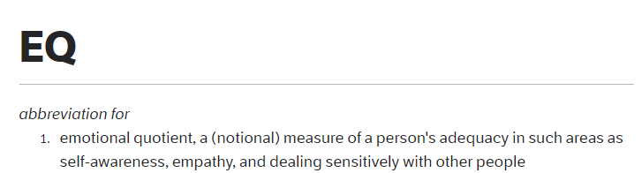
Empathise
Notes:
Requires Emotional Intelligence (EQ)
People with higher EQ progress further in their careers with better reputations (ref)
Employers are investing more in candidates that can display traits such as emotional intelligence, openness to change and collaborative skills to help build a stronger work culture. As such, 48% of 322 senior execs polled said critical thinking is the most sought-after soft skill, followed by complex problem solving at 33% and emotional intelligence at 29%. [Source: Aquent, recruitment firm for marketing and creative talent.]

Slide 12


Slide 13
Logical Levels
E
D
C
B
A
Weather, journey, non risky current affairs, observations
NVIRONMENT
O – JOB, ACTIVITIES
Job, Activities, Interests, common groundings
AN DO - SKILLS
Expertise that may be of interest to me.
Drivers of my behaviour, what is important to me, where I want to go or achieve.
ELIEFS, VALUES, VISION
M
Because of my Beliefs, Values and Vision I AM XYZ and I AM going to…
Notes:
Thinking about today and some of the interactions you have had with new friends and colleagues.
Start Standing up, and when you think about one of the early conversations you had today and the examples I provide, when the level was not discussed please sit down.
Stay standing if you had a conversation with someone that concerned the weather, travel, traffic, the venue or its location.
Stay standing if you asked or were asked a So what do you do? Type question whether that is work or who you work for etc.
Stay standing if that progressed to deeper understanding of what you do in your role, especially if it lead to a “oh I need to speak to you more later” comment.
Stay standing if your conversation progressed to why you do what you do, why you believe it’s the right thing to be doing or what you hope to achieve through doing your role.
Stay standing if the person answering made a statement to the effect of “I do X role because I want to achieve Y outcomes and I am going to do this by Z actions.”

Slide 14







What are Compassionate Behaviours?
The four behaviours of compassion are described below in the form of a compass, helping to navigate how we interact and engage with colleagues and citizens, whilst aligning with Health and Social Care values and beliefs:
Compassionate Behaviours Compass
How do we demonstrate compassionate leadership?
Examples Include:
Attending
Being present and paying full attention with those we lead. ‘listen with fascination’.
Enabling cultures where teams feel safe to be open about challenges, share their ideas and share a vision.
Helping
Understanding
Being wiling to offer help, intervene, to make a difference, remove obstacles and support people to do their job efficiently and provide quality care.
Requires listening deeply.
Understand the feeling and emotions and challenges faced by colleagues and those we lead.
Providing regular time for team reflection to enable sharing of learning and experiences.
N
Coproducing with colleagues and citizens
Empathising
Taking the time to listen in order to understand the challenges that colleagues face
Caring - feeling the strains, pains,
anxieties without being overwhelmed by those feelings. Being empathetic in your responses.

Slide 15
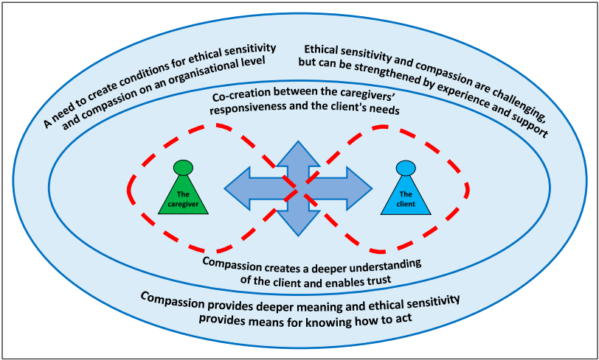
Evidence Based Practice
Compassionate Cultures
Better quality of life
Fewer ED (A&E) admissions
Better patient and family experiences
“[If we] …fail to be sensitive and compassionate with patients, good and high qualitative home care cannot be achieved” ( Blomqvist et al, 2023)
“there is a correlation between the work environment and the caregiver’s ethical sensitivity.” (Huang et al, 2016)
Compassionate Conversations and Mental Health
Significant reductions in Depression, Anxiety, Distress and improved Well Being
Demonstrating Compassionate care lead to increase in service users/clients becoming more involved in their own care in terms of participation and engagement. (Lloyd & Carson, 2011)
Notes:
Care homes – Compassionate Conversations lead to quality of life, trust in those care givers rather than the Doctors, the Gods in their eyes.
Blomqvist et al – the need for better care at home starts with compassion; “a sensitivity to the needs and suffering of ourselves and others” M West
Huang – the need for organisations to foster and promote compassionate behaviours to enable ethical sensitivity in difficult situations to be able to understable and empathise with the clients situation and their needs and make decisions of care based on the balancing of physical and ethical needs.

Slide 16
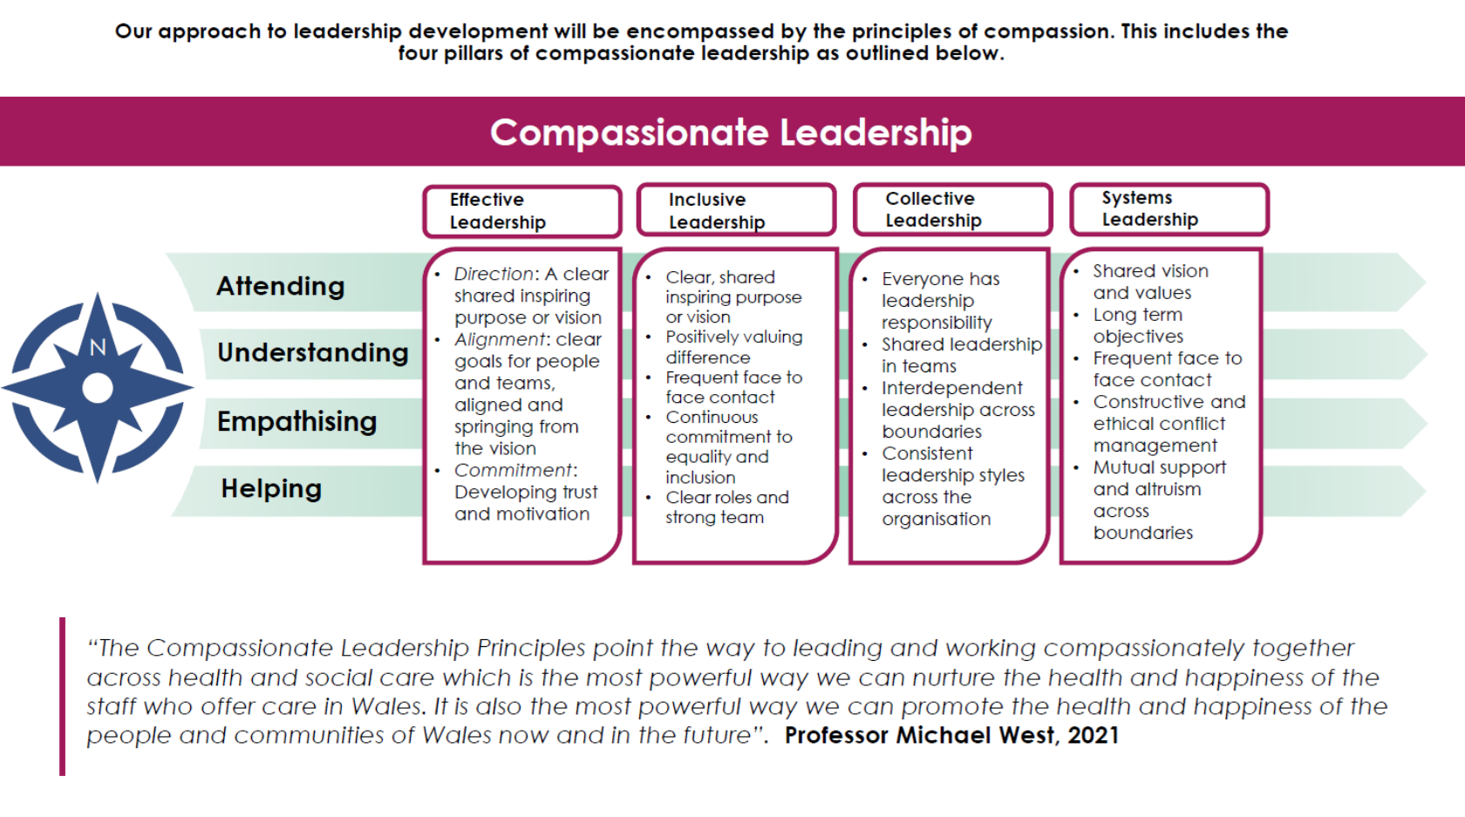
Where next?

Slide 17
Where next?
Compassionate Leadership Programme – The Powys Compassionate Leader – (3 Day F2F)
Fundamentals of Coaching – (2 Day F2F)
Professional Leadership Immersive Programme – contact us for information on this
PAVO newsletter – H,SC&C Academy and ILA courses information
Gwella Leadership Portal - leadershipportal.heiw.wales (Compassionate Leader Self Assessment and 360 tool, inc Powys Joint Leadership Conference Recordings)
Social Care Wales - socialcare.wales/resources-guidance
IHSCM - IHSCM (ihm.org.uk) (Free membership via Gwella)
Powys Coaching Network – Access via sharepoint for PCC and PTHB, - PAVO staff email
powyscoachingnetwork@powys.gov.uk
Please speak to us about the Core and Bespoke Leadership and Team Development
Support on offer from the Academy Team

Slide 18

Food For Thought
Notes:
(35) Professor Michael West Leadership in todays NHS - Clip 3 of 3 – YouTube – M West domino effect

